Slide 1

A Dual Analysis of NYC Business Licenses
A Machine-Learning Approach
Team #8 | CS667 – Practical Data Science
Members :- Ronak Pipaliya | Sajan Shergil |
Darpan Gorasiya
Instructor: Dr. Krishna Bathula

Slide 2

Introduction
This presentation provides an overview of the analysis conducted on the NYC Business Licenses dataset containing over 66,000 records across the five boroughs.
It highlights the methodologies used to predict missing business geolocations through regression modeling and forecast license renewal or lapse through classification.
The presentation outlines key data cleaning steps, machine learning techniques, model evaluations, and the insights derived to support data-driven decision-making for business regulation and urban policy planning.

Slide 3
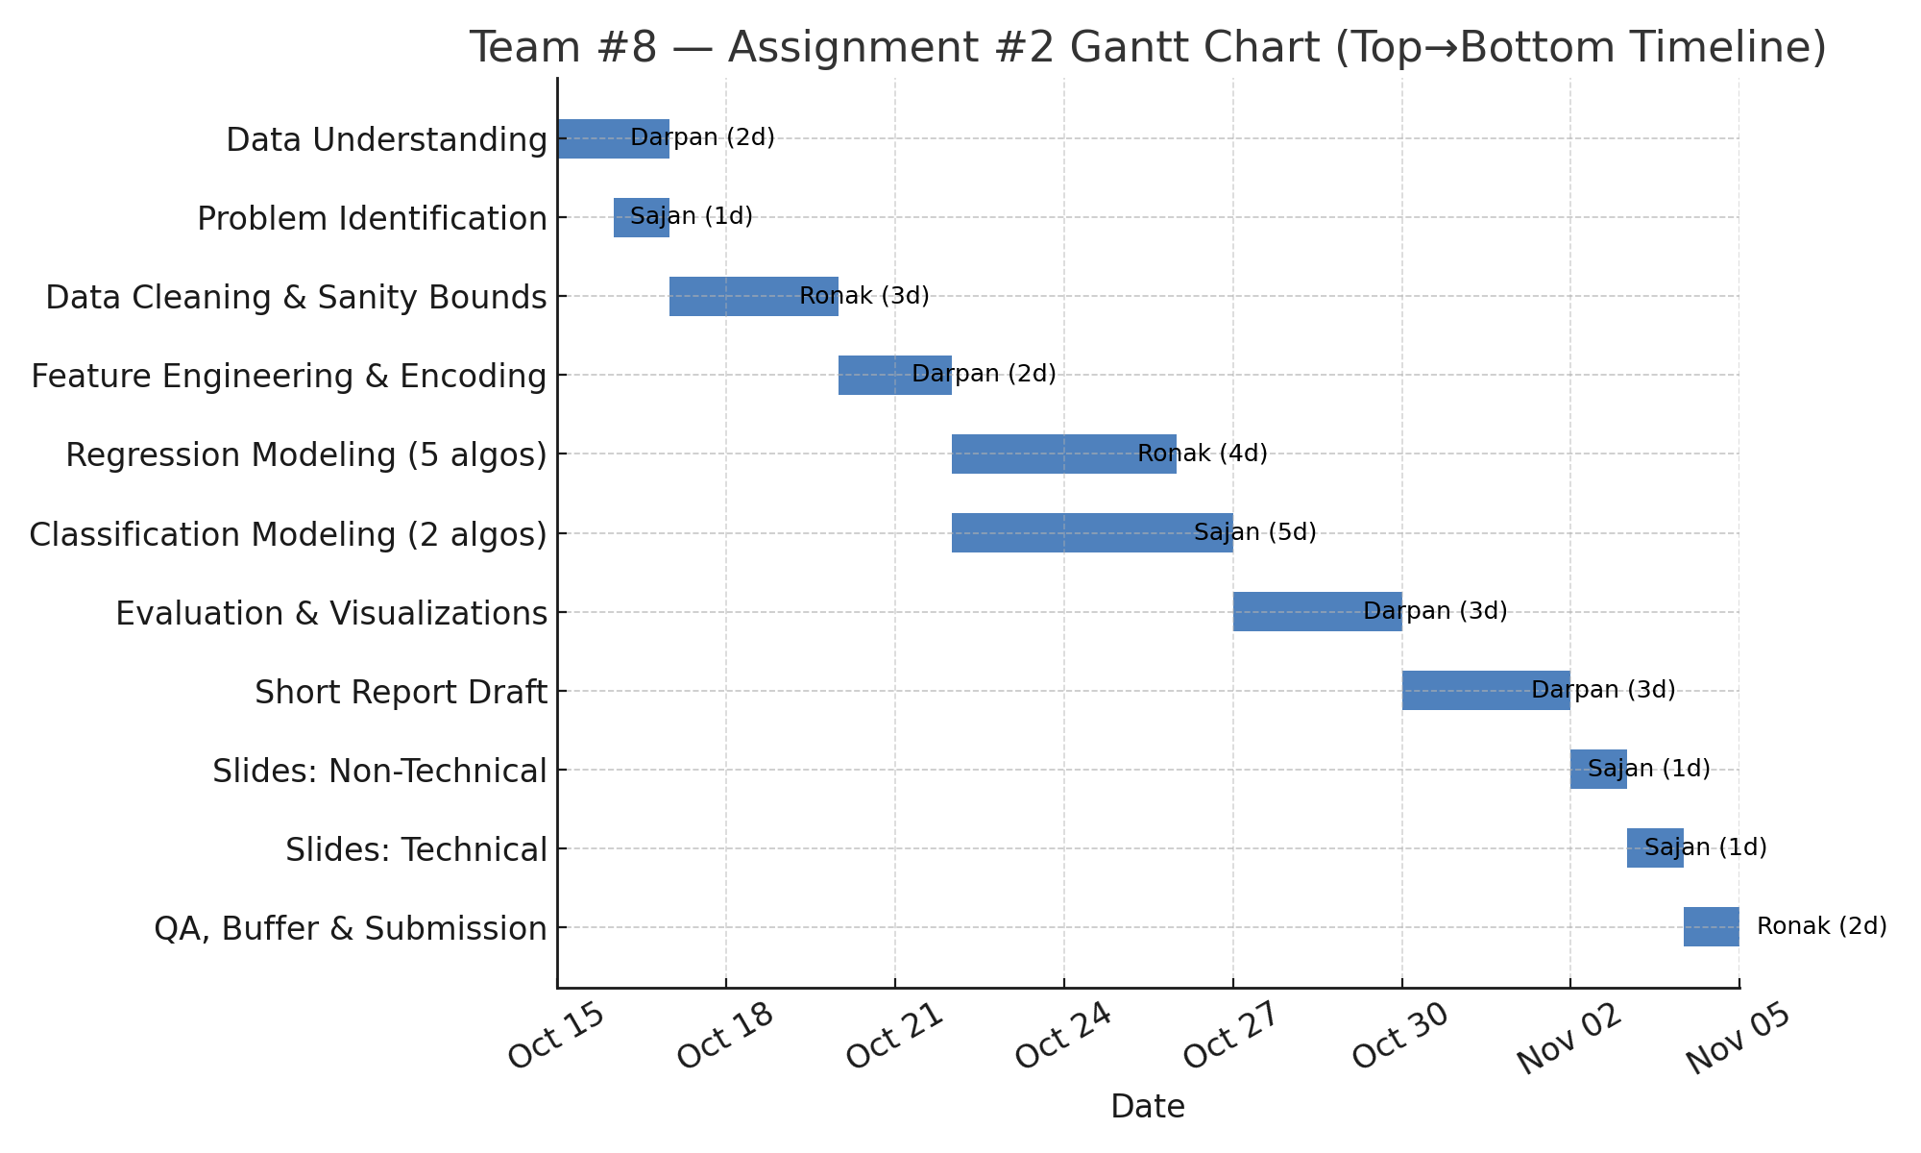

Slide 4

Loaded Dataset The NYC Business Licenses dataset was loaded into a Pandas Dataframe for preprocessing and exploration. The dataset contained approximately 66,000 records and 31 attributes, covering business details, license information, geographic identifiers, and issuance timelines.
Initial Data Inspection Exploratory methods such as head(), info(), and describe() were applied to understand the dataset’s structure, data types, and completeness. This preliminary inspection revealed multiple missing fields, mixed data types, and non-standard ZIP code formats—indicating the need for thorough data cleaning and transformation before analysis.

Slide 5
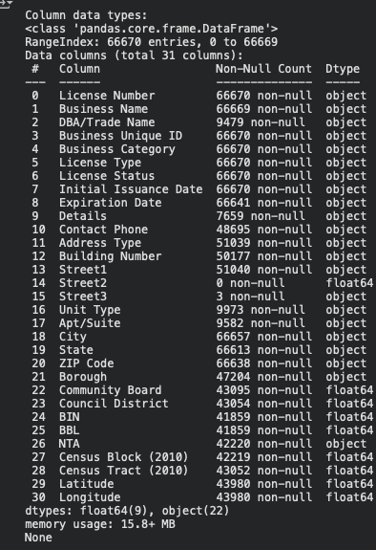
Dataset Overview

Slide 6
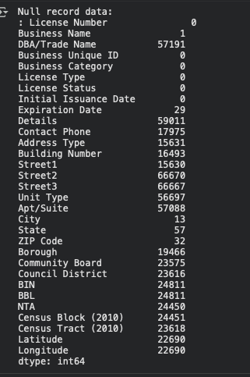
Data preprocessing & cleaning
Check the null value
Initial issuance date/Expiration date converted to datetime.
Cardinality of object columns shows the important features need to taken into consideration for model training.
Identifying object type columns, exclude identifier columns, calculate the number of unique values for each, and print the results to assess cardinality for one-hot encoding suitability.

Slide 7
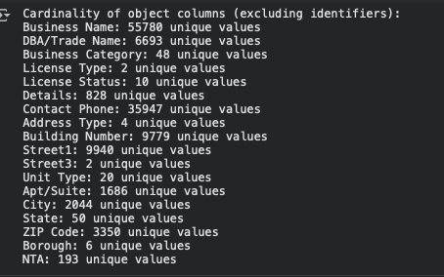

Slide 8
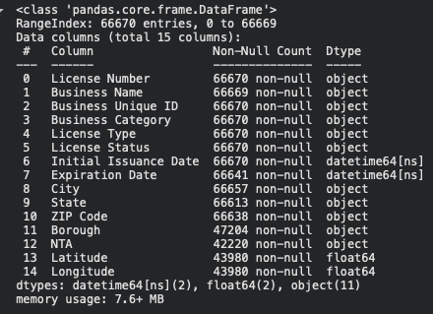
ONE HOT ENCODED COLUMNS
Dataset contains 66,670 records and 15 features after cleaning.
Focused on NYC-based businesses only (removed “Outside NYC”).
Data types: 11 categorical, 2 numeric, 2 datetime.
Missing values present in Borough, NTA, Latitude, and Longitude.
Datetime conversion: Initial Issuance Date, Expiration Date → datetime64.
Dataset size: ~7.6 MB, memory-efficient for Pandas operations.
Structured and ready for feature engineering (encoding, imputation, scaling).

Slide 9
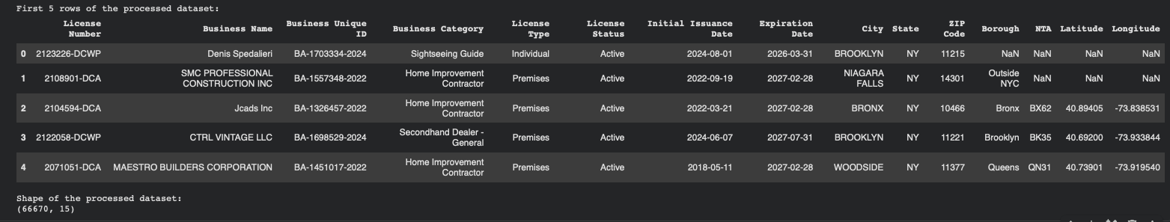

Slide 10
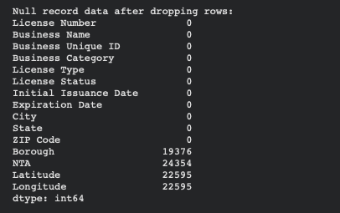
Impute missing value with median and mode
Key Steps:
ZIP Code: Standardized to 5-digit numeric format; removed invalid and non-NYC entries.
Borough: Filled missing values using ZIP-to-Borough mapping.
NTA: Imputed using ZIP-to-NTA relationships derived from valid records.
Latitude & Longitude: Retained as targets for regression prediction.
Result:
Dataset refined from 66,670 → ~56,000 records (NYC-only).
All categorical fields cleaned and spatial hierarchy (ZIP → Borough → NTA) restored.
Remaining missing values limited to coordinates for the regression task.

Slide 11
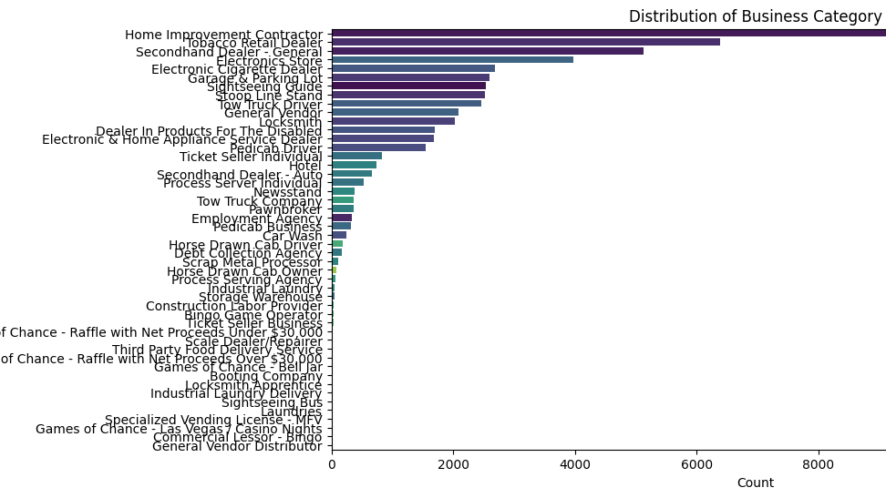

Slide 12
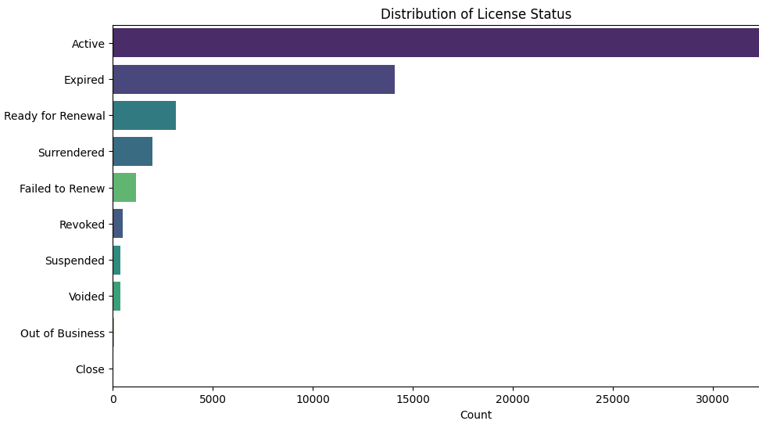

Slide 13
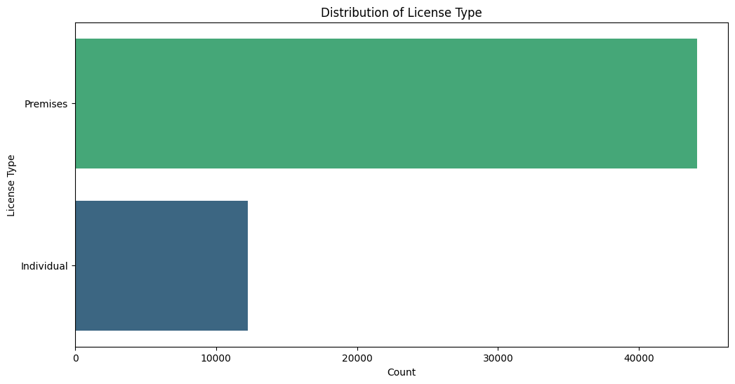

Slide 14
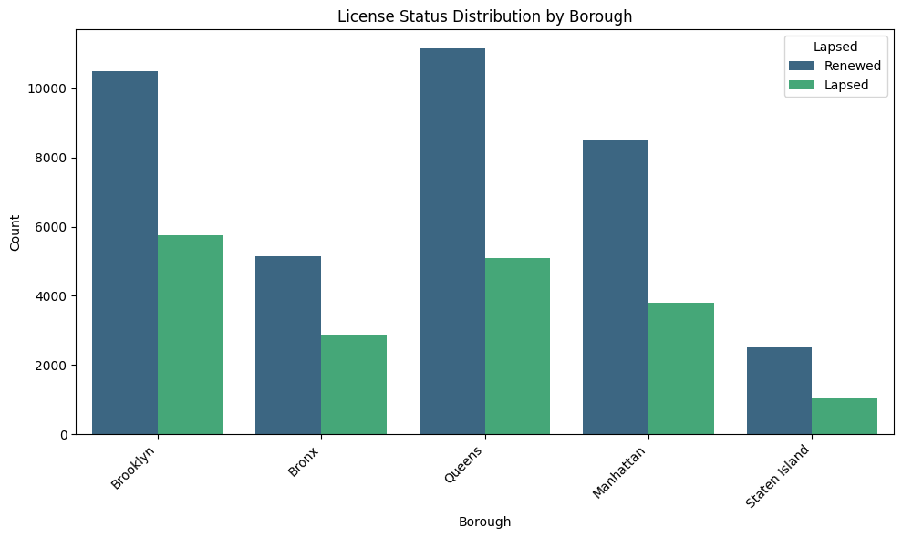

Slide 15
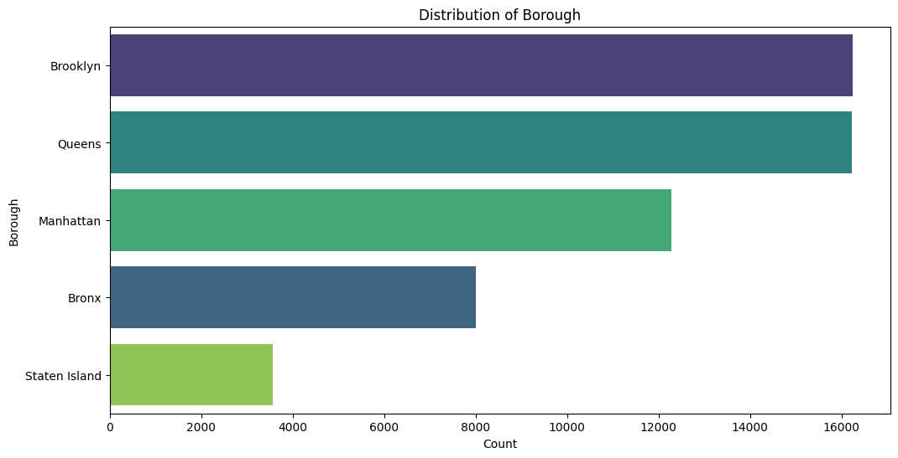

Slide 16
City Value Insights
Practical Applications of Data
Auto-filling Records
Urban Planning
Targeted Outreach
Data-driven approaches allow for
seamless auto-filling of business records, reducing manual entry errors and
improving efficiency, ultimately enhancing
the accuracy of city databases for better resource allocation.
Analyzing license data aids urban planners
in identifying growth areas and optimizing infrastructure development, ensuring
that resources are allocated where they
are most needed to support community growth.
Leveraging insights from business patterns enables targeted outreach strategies, allowing city officials to connect effectively with entrepreneurs, fostering a supportive environment for new and existing businesses in NYC.

Slide 17
Task 1-classification
Predict whether a business license issued by DCWP is likely to lapse (1) or renew (0) using available license-level attributes.
The goal is to identify renewal behavior patterns to support DCWP in prioritizing renewal reminders and compliance outreach.
🧩 Dataset Overview
Data Source: NYC Open Data — DCWP Issued Licenses
Key Features Used:
Business Category → industry sector of the licensee
Borough → geographic region
License_Duration → calculated from Initial Issuance Date to Expiration Date (in days)
Target Variable: Lapsed (1 = license not renewed)
Size: 56,000+ records after cleaning and transformation.

Slide 18
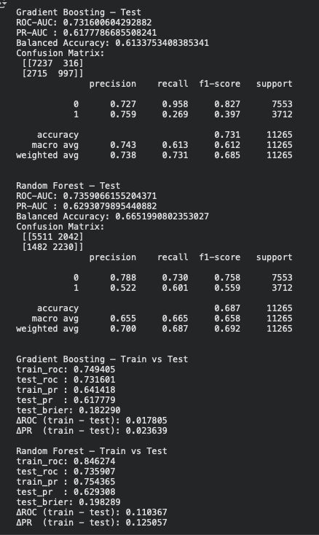
Models Trained
Two tree-based models were implemented and compared:
Model | Key Characteristics
Gradient Boosting Classifier | Sequentially builds weak trees, focusing on difficult samples; well-calibrated and strong generalization.
Random Forest Classifier | Ensemble of independent trees (bagging); robust, slightly higher recall, minor overfitting risk.

Slide 19
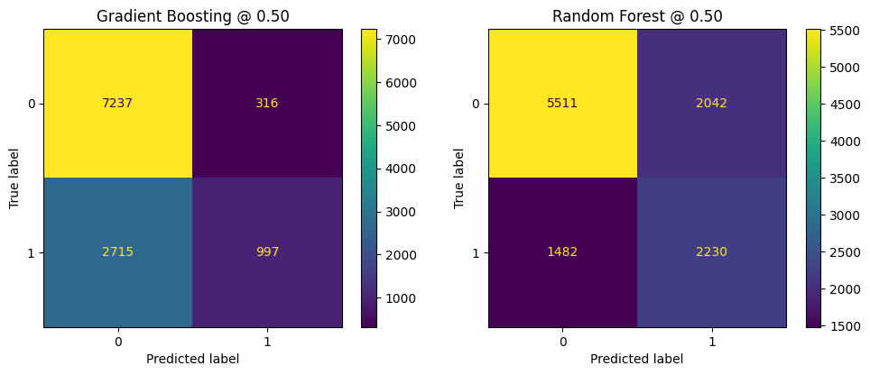
TRAINING RESULTS

Slide 20
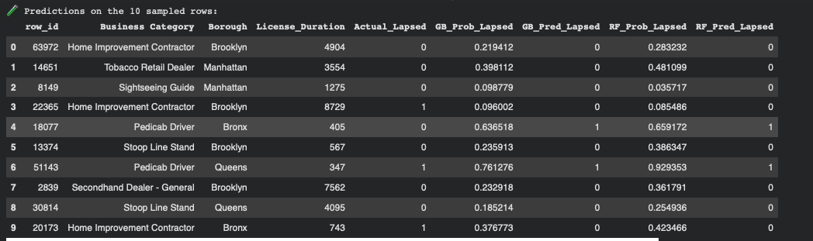
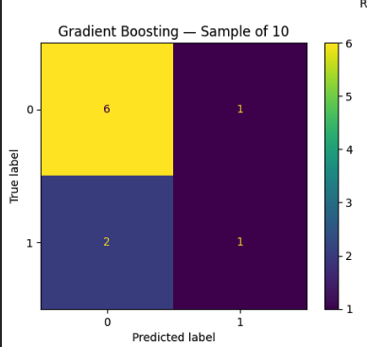
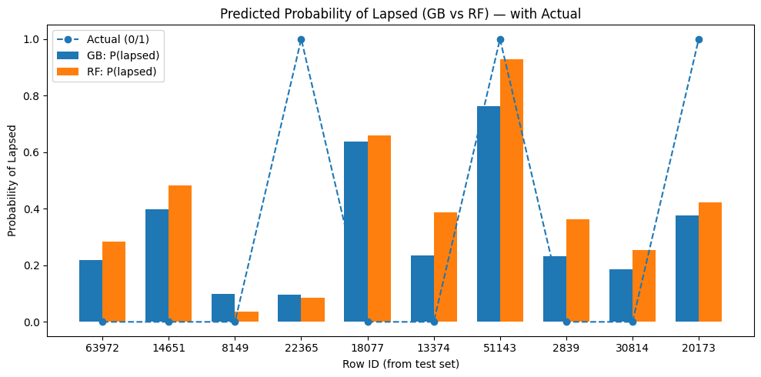
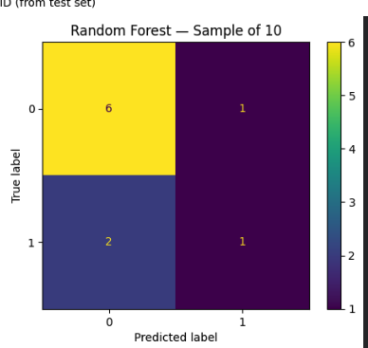
Taking 10 random samples from the dataset to test the model:-

Slide 21
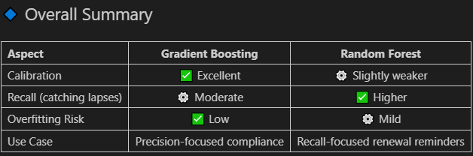
Final Insights-classification
Conclusion: Both models generalize well and are suitable for deployment.
Gradient Boosting is ideal for policy or compliance insight, while Random Forest suits renewal prediction and outreach.
Interpretation & Impact
License Duration is a key predictive factor; shorter durations correlate with higher lapse risk.
Business Category and Borough influence renewal patterns, hinting at geographic-sector renewal behavior.
Models provide a reliable basis for renewal outreach prioritization, allowing DCWP to focus on at-risk licenses.

Slide 22
Task 2-REGRESSIOn
Many license records in the DCWP dataset lack valid Latitude / Longitude values.
The goal of this model is to predict both coordinates simultaneously using spatially related categorical features:
1. ZIP Code
2. Borough
3. Business Category

Slide 23
Models Trained
Two tree-based models were implemented and compared:
Model | Key Characteristics
Random Forest Regressor | Best performance, high stability, interpretable feature importances -RMSE (≈ 0.037) -R² (≈ 0.8115)
Gradient Boosting Regressor | Comparable accuracy with finer calibration potential -Identical RMSE -stable spatial pattern

Slide 24
TRAINING RESULTS
Random Forest Results :-
Train — R²: 0.8060, RMSE: 0.03763, MAE: 0.02847
Test — R²: 0.8115, RMSE: 0.03717, MAE: 0.02826
Valid — R²: 0.8097, RMSE: 0.03723, MAE: 0.02837
Gradient Boosting Results:-
Train — R²: 0.8059, RMSE: 0.03764, MAE: 0.02852
Test — R²: 0.8115, RMSE: 0.03717, MAE: 0.02830
Valid — R²: 0.8098, RMSE: 0.03722, MAE: 0.02841
Conclusion
Both models perform identically, with little difference across the three phases of model training
Performance Summary
Models tested:
Random Forest & Gradient Boosting (multi-output regression).
Metrics (Average across splits):
-R² ≈ 0.81 — strong predictive accuracy
-RMSE ≈ 0.037° → ≈ 3–4 km spatial deviation
-MAE ≈ 0.028 — low average error
Minimal difference between train, test, and validation → no overfitting.

Slide 25
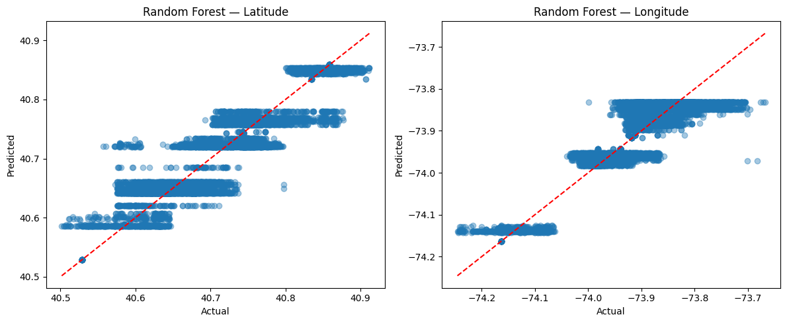

TRAINING RESULTS
Random Forest:-
Red line : Line of “Perfect Prediction”.
Blue Dots: (test, pred) dots.
The vertical distance from any point
to the line is the "error" for that
single prediction.
Gradient Boosting:-

Slide 26
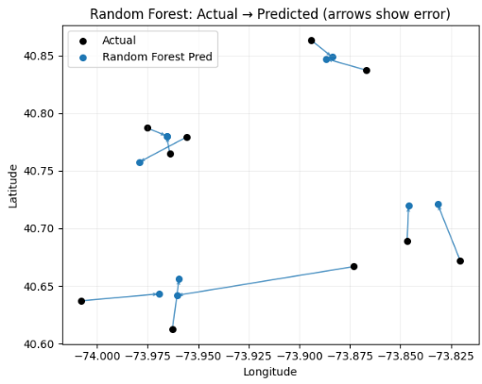
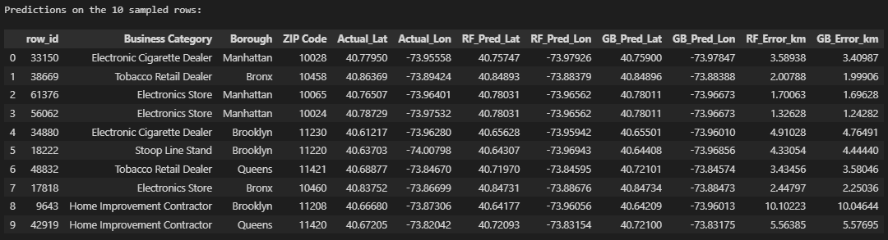
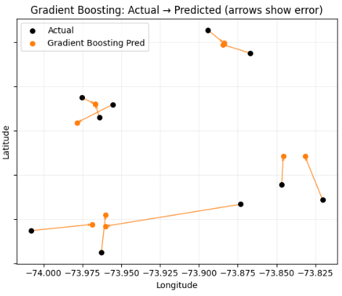
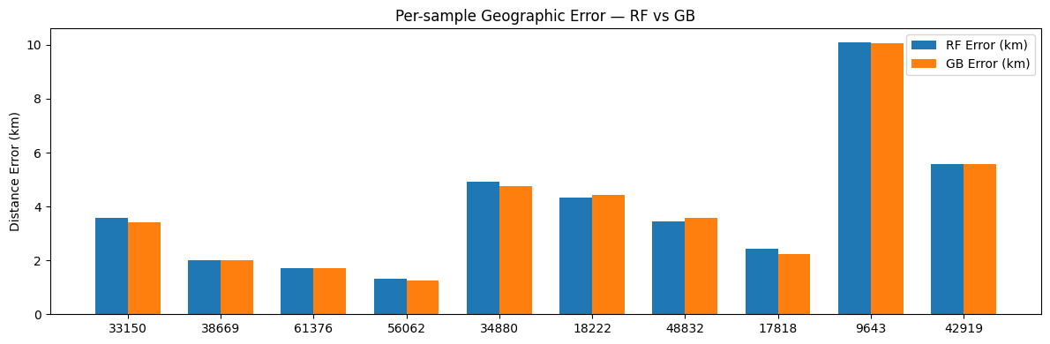
Taking 10 random samples from the dataset to test the model:-

Slide 27
🗺️ Geospatial Prediction Visualization — Actual vs Predicted
🔍 Arrow Map (Actual → Predicted) :-
- Each arrow starts at the actual business location and points toward the predicted coordinate.
- The arrow length indicates how far off the prediction was — longer arrows = larger spatial error.
- Most arrows are short and closely aligned, meaning both Random Forest and Gradient Boosting models predicted very close to true coordinates.
- A few longer arrows (e.g., 5–9 km range) indicate outliers where model uncertainty was higher, often within dense boroughs (Queens or Manhattan).
📏 Error Table (in km)
- The table quantifies the per-record prediction error.- Average prediction error across models ≈ 3–4 km, confirming consistent accuracy.
- Both models perform nearly identically, with Random Forest slightly more stable on average.
- Higher errors occur where ZIP Code or Business Category data were sparse — suggesting feature enrichment (like street-level clusters) could further improve performance.

Slide 28
Final Insights-regression
- Enables accurate geolocation recovery for incomplete records.
- Supports spatial mapping, clustering, and zoning analysis.
- Improves data completeness and quality for DCWP licensing analytics.
Recommended model: Random Forest Regressor — best balance of speed, stability, and precision.

Slide 29

THANK YOU

